Slide 1

Wine Quality
Muhammad Shazwar bin Anuar -WIE160015
Mohamad Aiman Arif bin Mohamat Saat - WIE160010

Slide 2
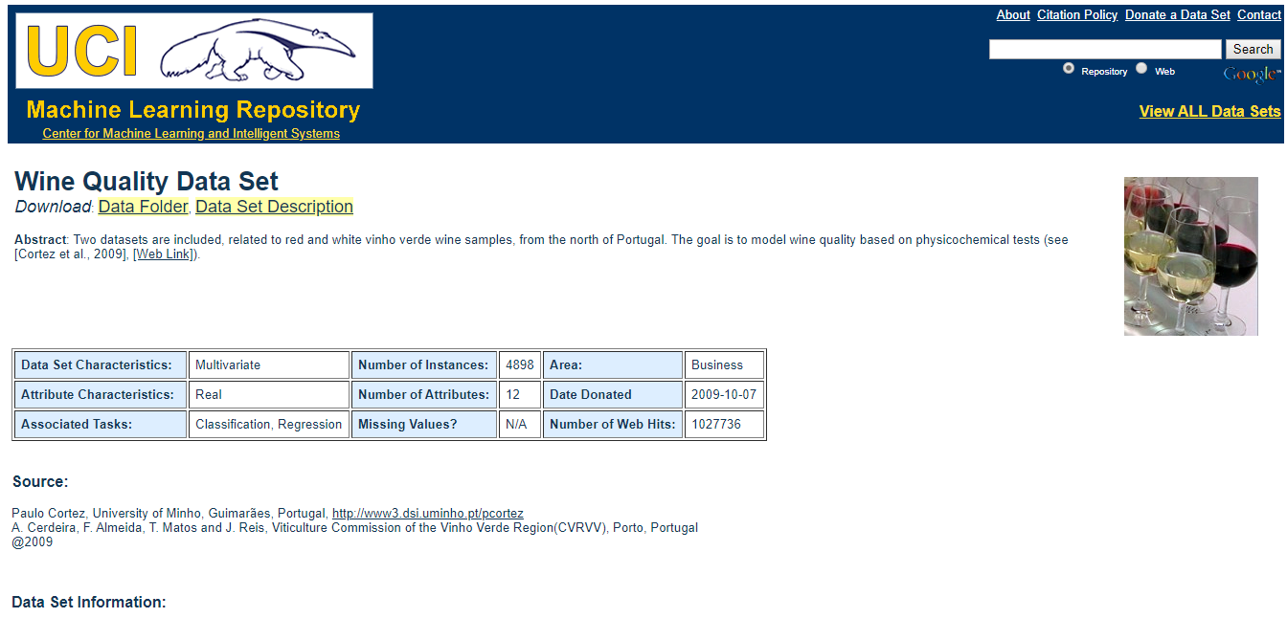
Dataset sOURCES

Slide 3
Analysis Goal
To identify the what factor that make the good wine
Analysis Data
Extracted from the red wine research
Inputs include objective tests (e.g. PH values)
The output is based on sensory data (median of at least 3 evaluations made by wine experts)

Slide 4
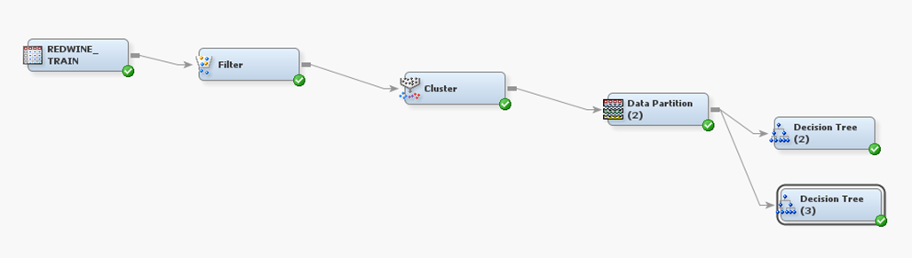
dIAGRAM
Diagram shows the diagram with highlighted on cluster node

Slide 5
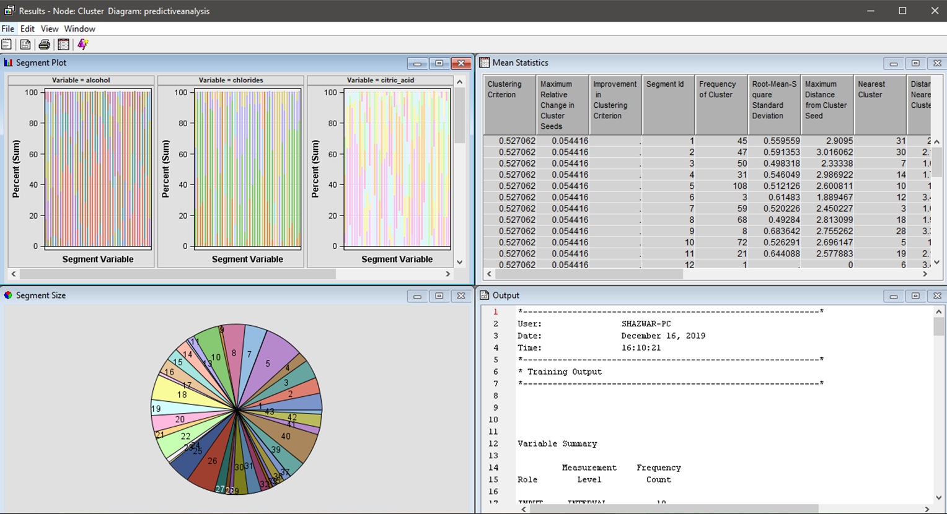
cLUSTER
Diagram shows the result when cluster node run

Slide 6
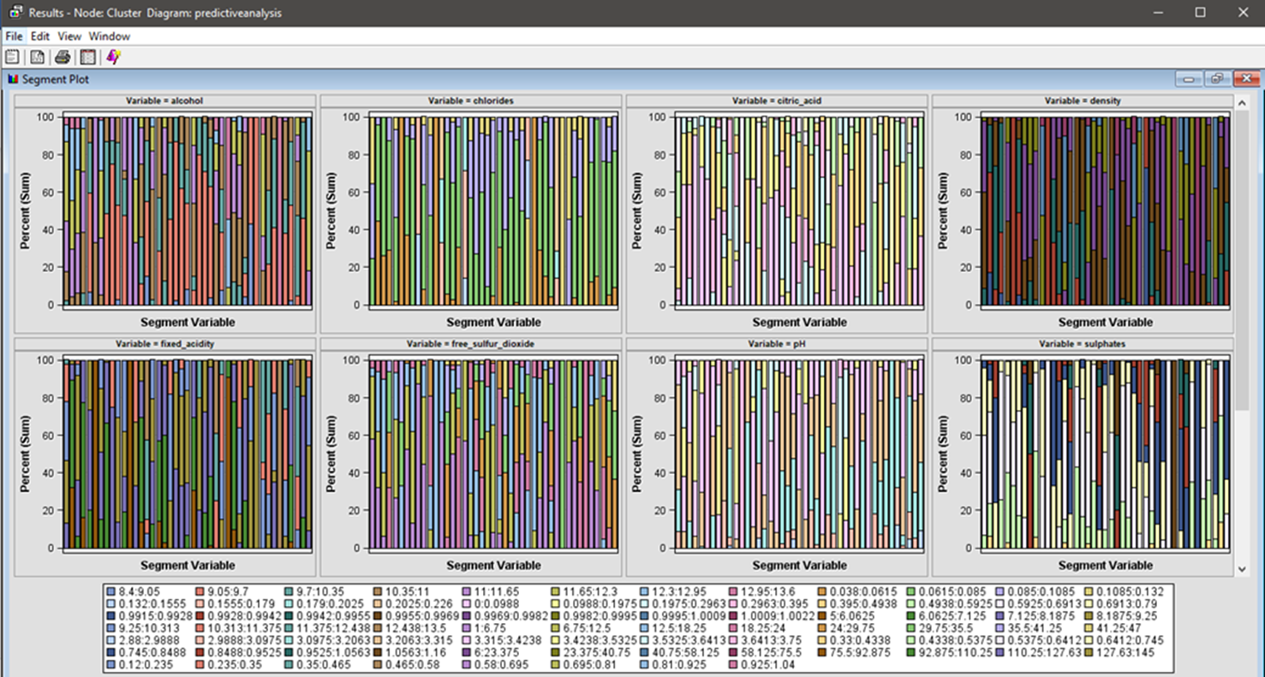
cLUSTER
Diagram shows the segment plot

Slide 7
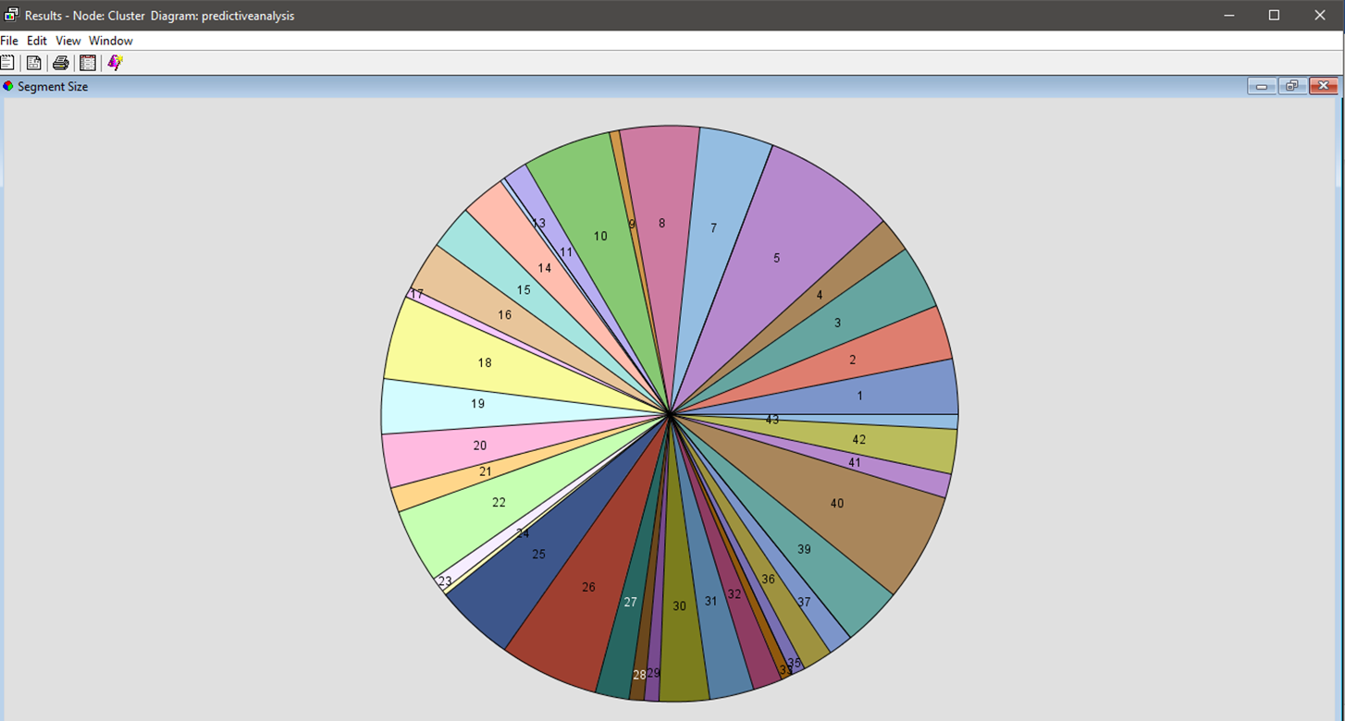
cLUSTER
Diagram shows the segment size

Slide 8
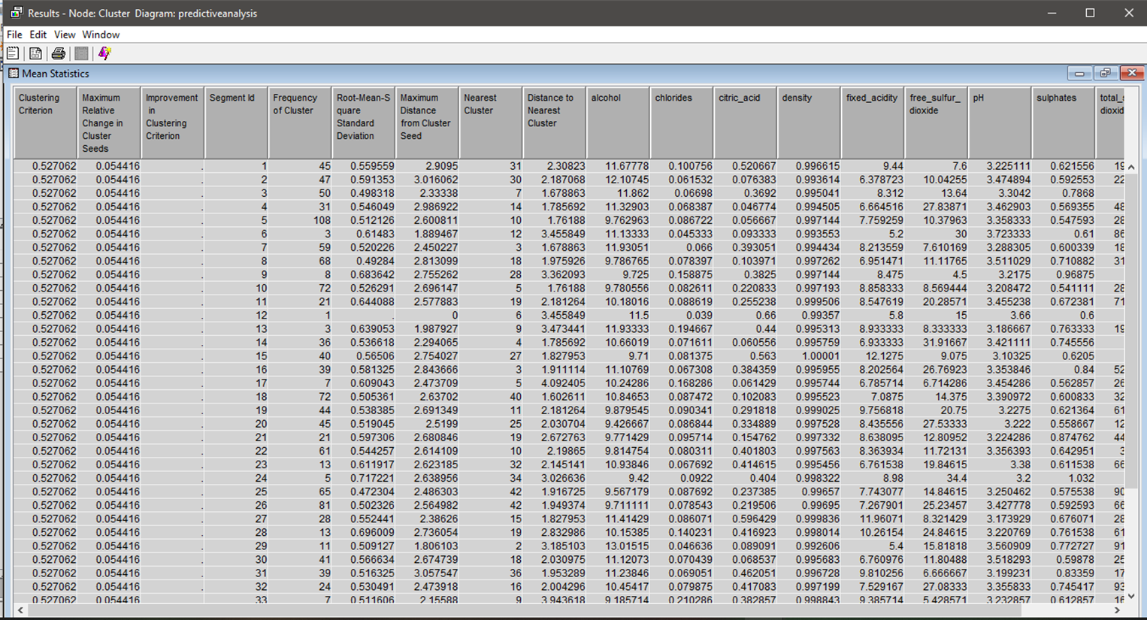
cLUSTER
Diagram shows the mean statistics

Slide 9
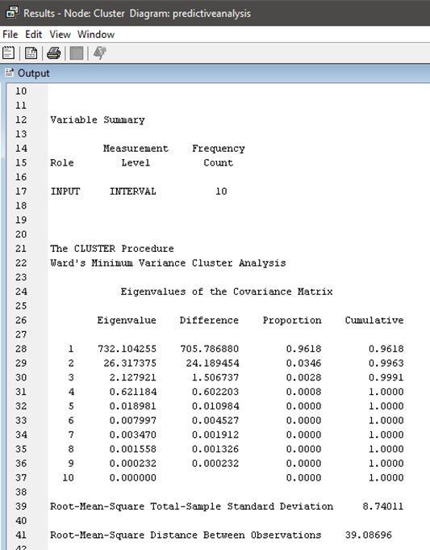
cLUSTER
Diagram shows the output summary

Slide 10
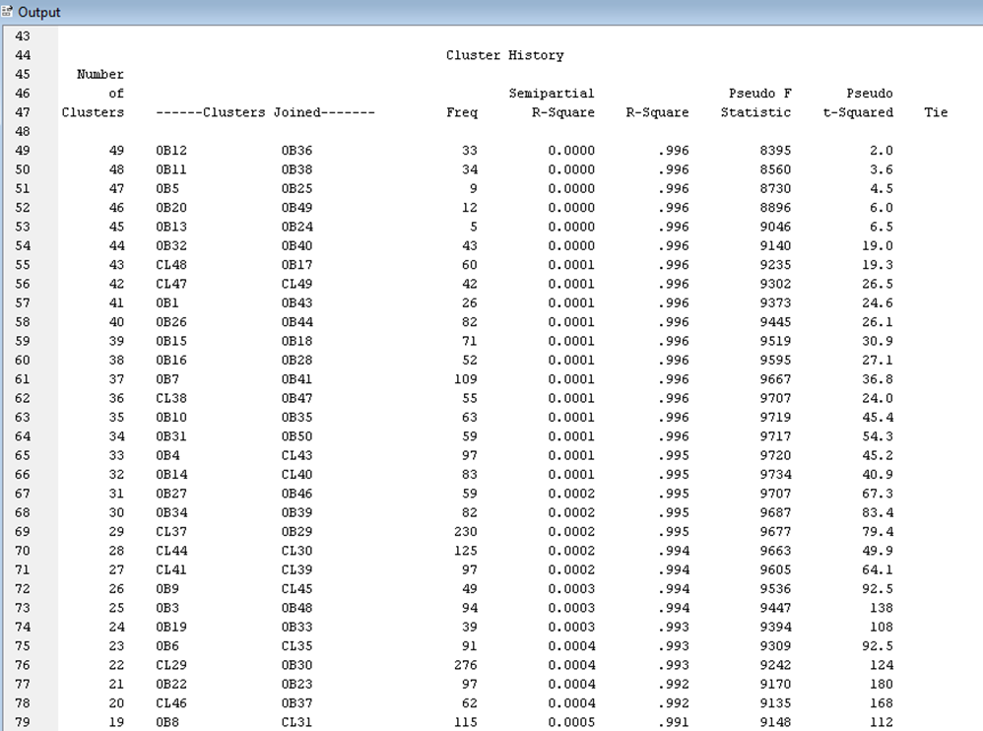
cLUSTER
Diagram shows the output summary

Slide 11
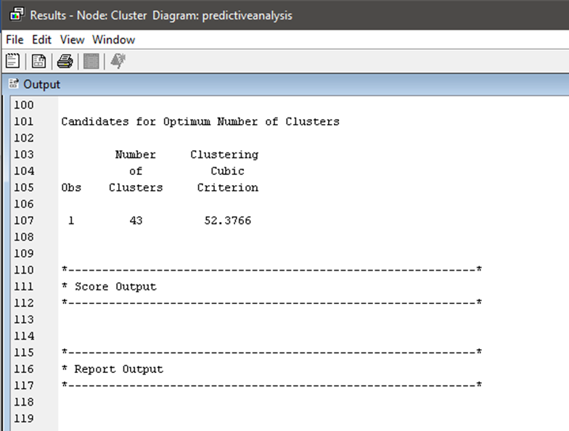
cLUSTER
Diagram shows the output summary

Slide 12
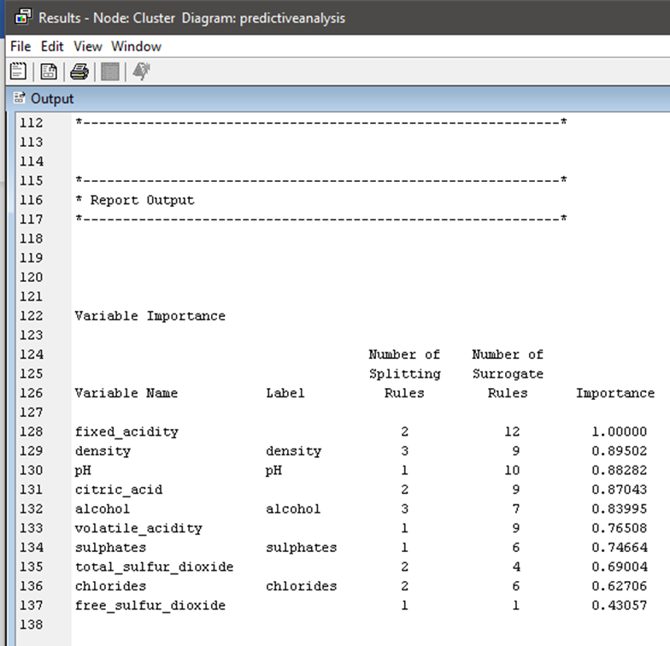
cLUSTER
Diagram shows the report output summary

Slide 13
dIAGRAM
Diagram shows the diagram with highlighted on data partition node

Slide 14
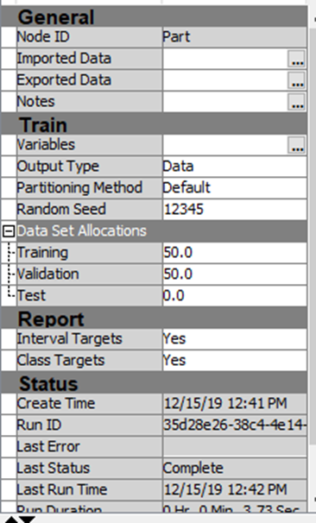
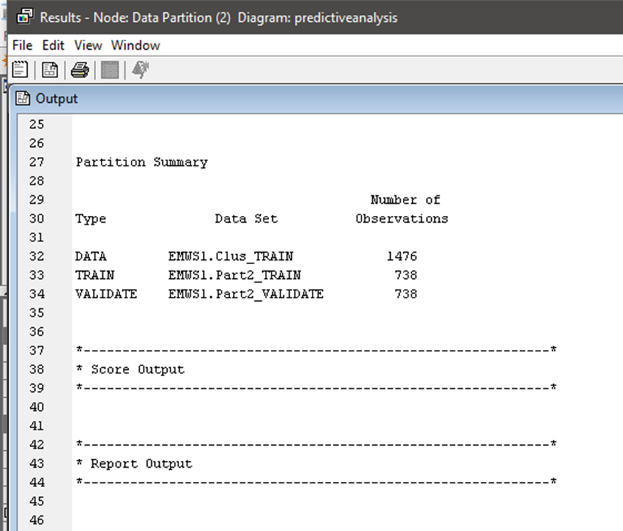
Data partition
Diagram shows the attribute table
Diagram shows the data partition output

Slide 15
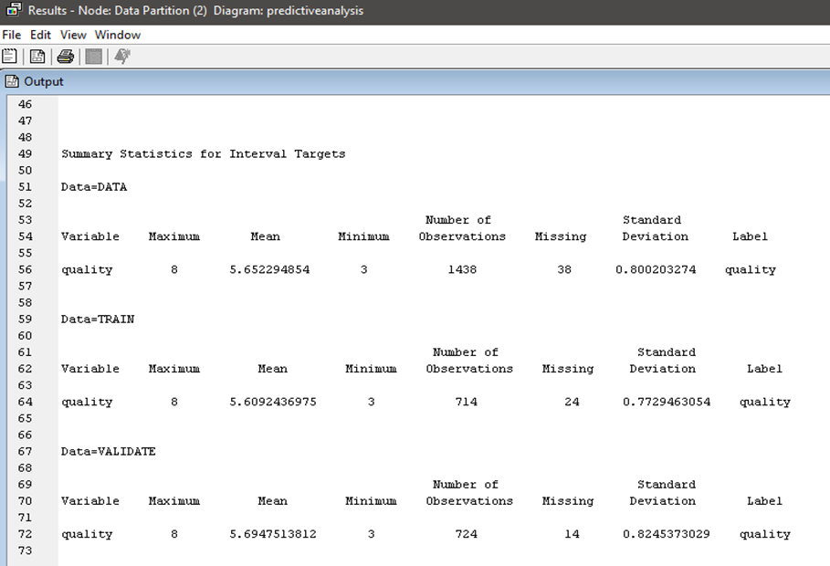
Data partition
Diagram shows the output summary

Slide 16
dIAGRAM
Diagram shows the diagram with highlighted on decision tree(2) node

Slide 17
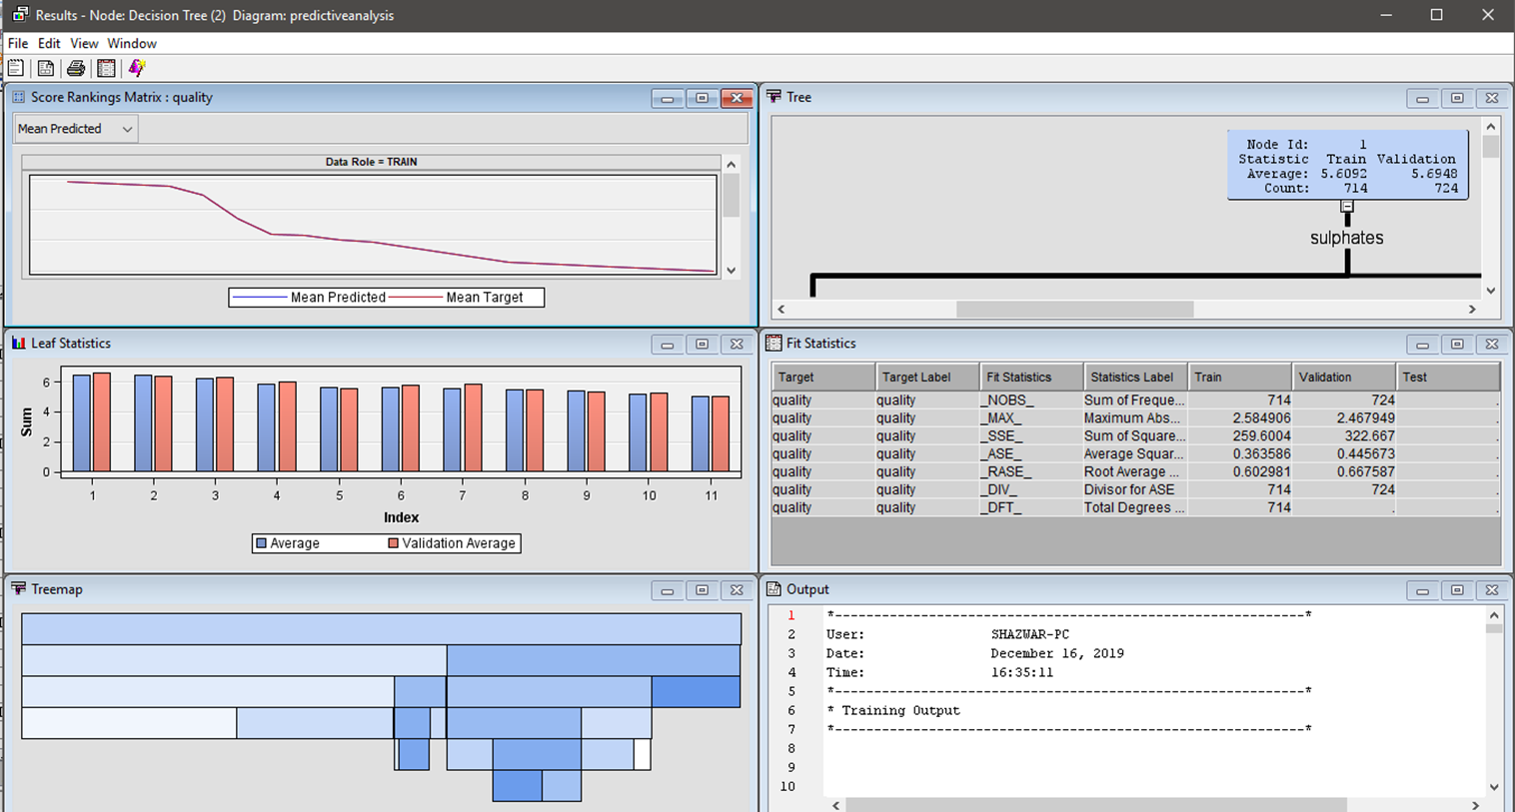
DECISION TREE
Diagram shows the result of decision tree(2)

Slide 18
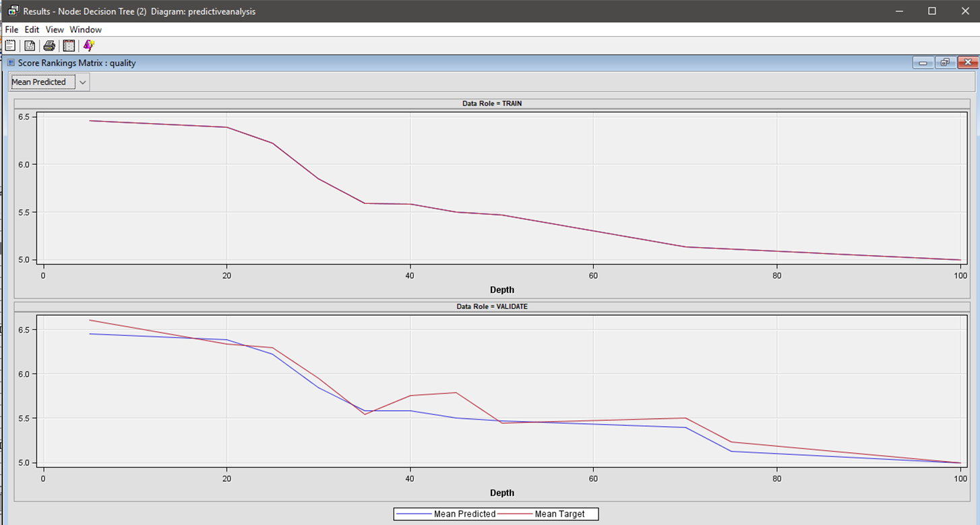
DECISION TREE
Diagram shows the score ranking matrix

Slide 19
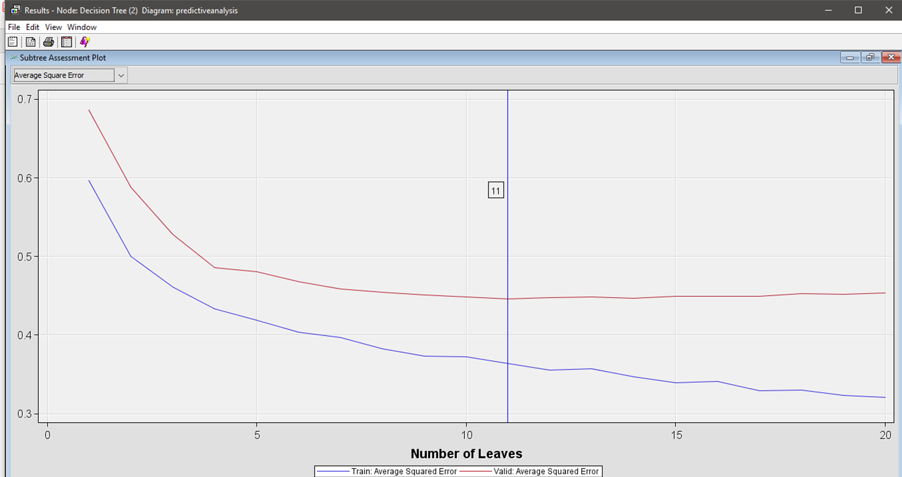
DECISION TREE
Diagram shows the subtree assessment plot and leaves

Slide 20
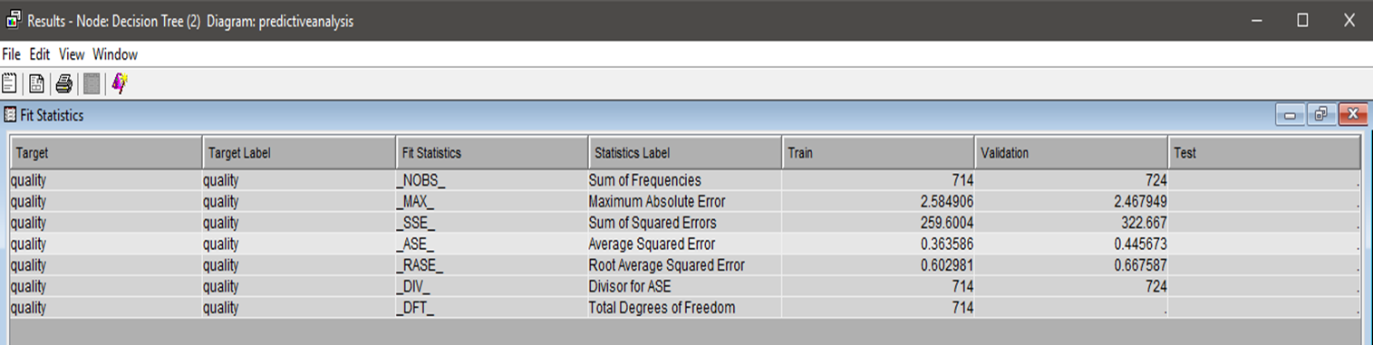
DECISION TREE
Diagram shows the validation value of quality

Slide 21
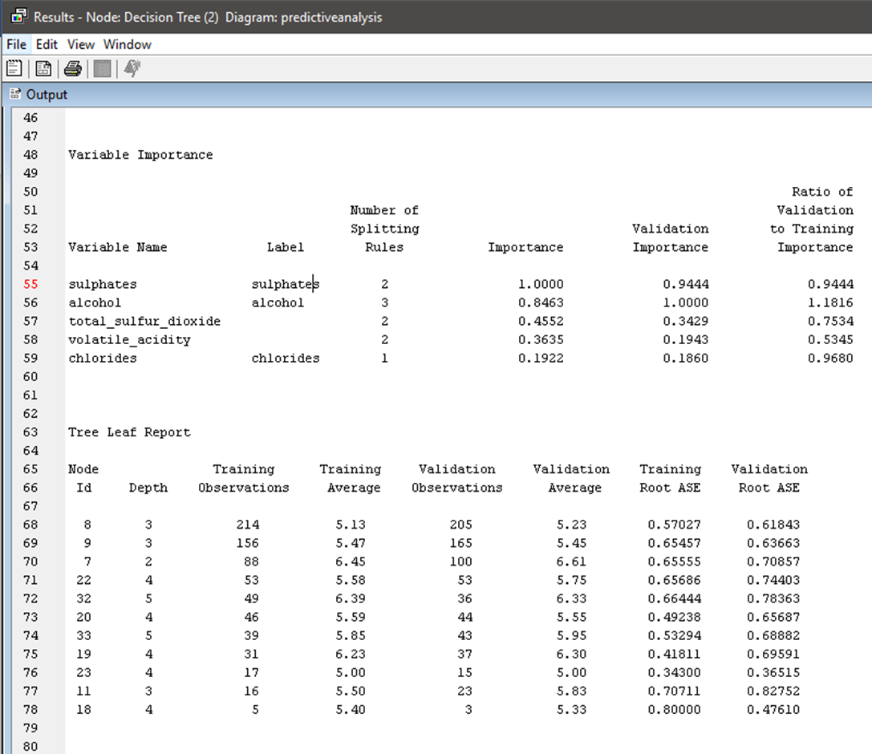
DECISION TREE
Diagram shows the output of tree leaf report

Slide 22
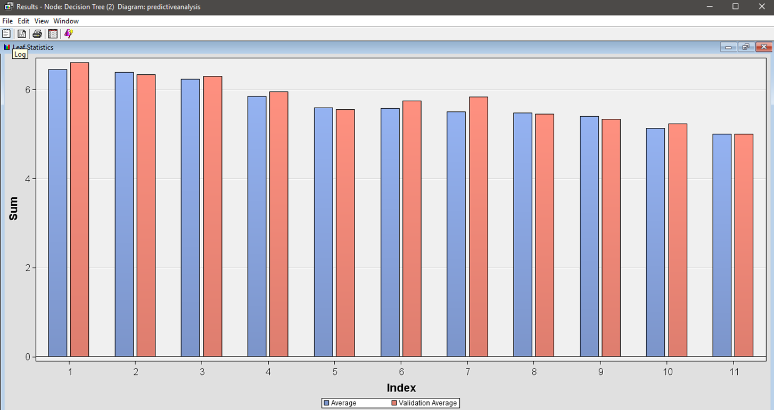
DECISION TREE
Diagram shows the leaf statistics for 11 leaf

Slide 23
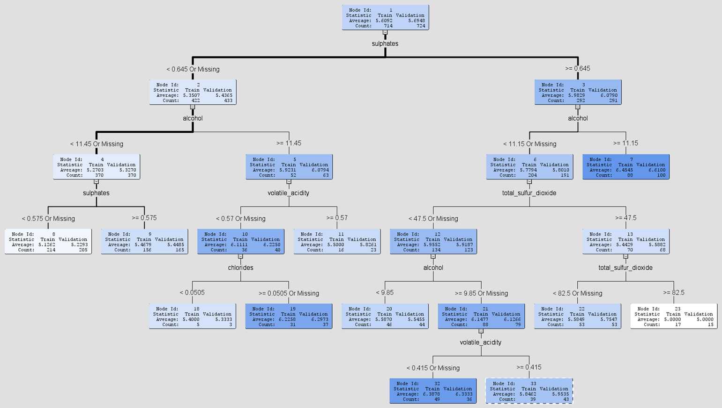
DECISION TREE
Diagram shows the decision tree with 2 branch

Slide 24
dIAGRAM
Diagram shows the diagram with highlighted on decision tree(3) node

Slide 25
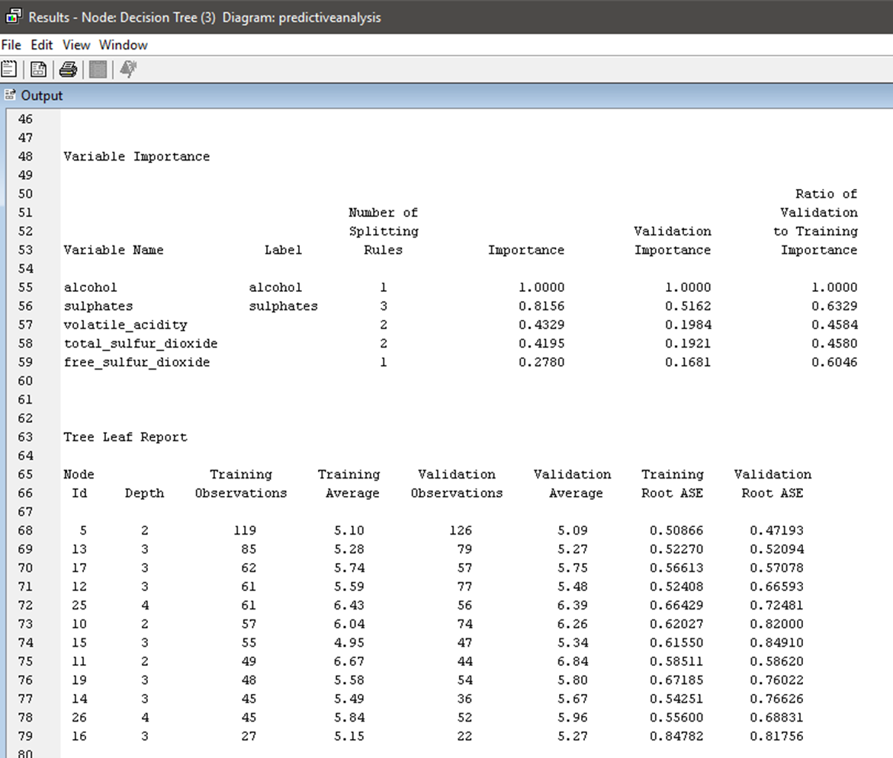
DECISION TREE
Diagram shows the output of tree leaf report

Slide 26
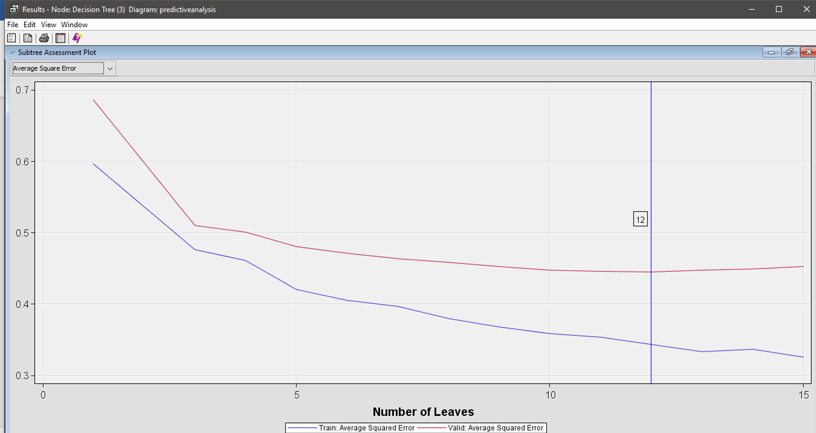
DECISION TREE
Diagram shows the subtree assessment plot and leaves

Slide 27
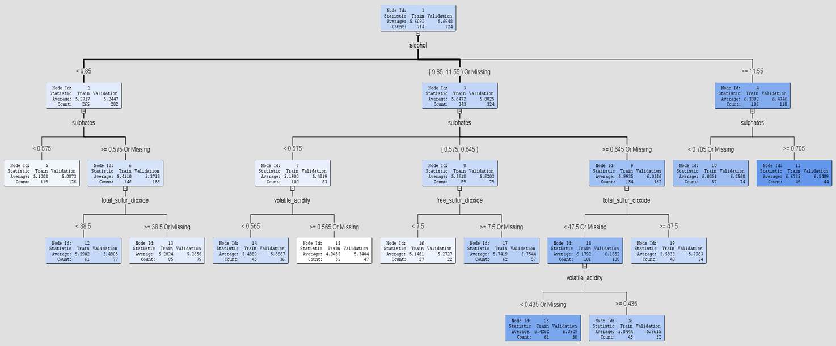
DECISION TREE
Diagram shows the decision tree with 3 branch

Slide 28
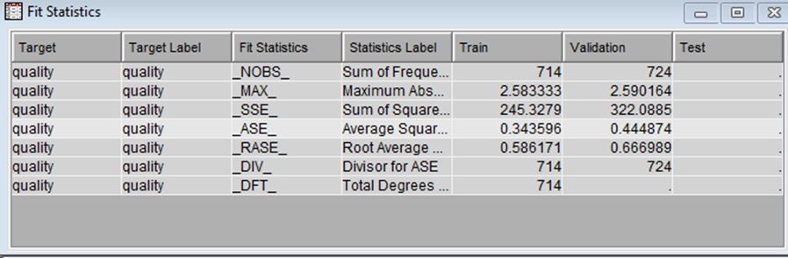
DECISION TREE
Diagram shows the validation value of quality

Slide 29
dIAGRAM
Compare
Compare decision tree(2) and decision tree(3)

Slide 30
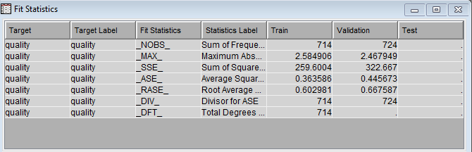
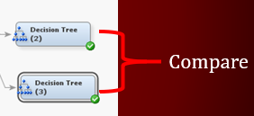
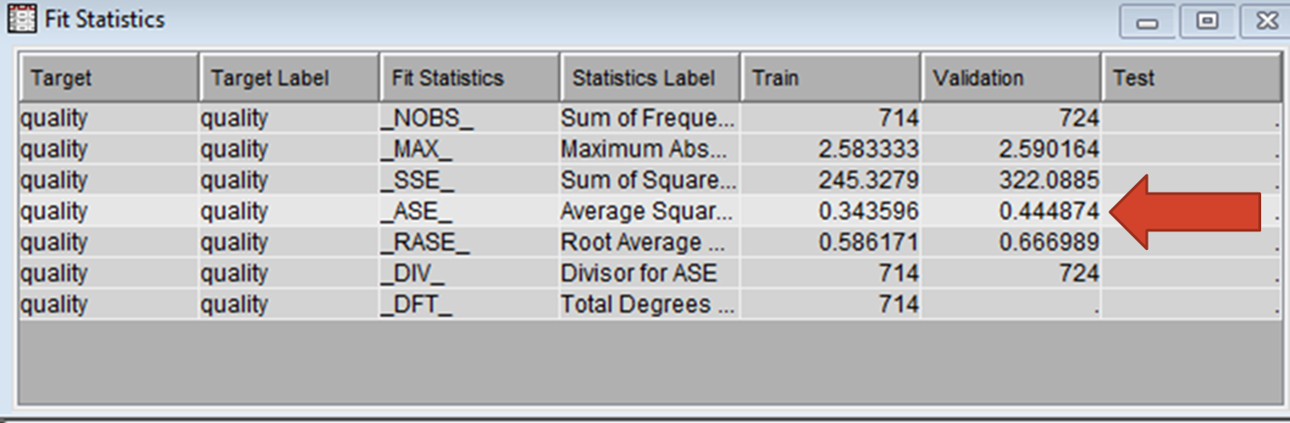
Decision tree
Compare decision tree(2) and decision tree(3)

Slide 31
THANKS ☺

